Slide 1

Siddharth Kulkarni | Omkar Patil | Atharv Chaudhari | Rutuja Vaidya | Sana Shaikh
Domain: Machine Learning & Data Science
Guided By: Dr R.V. Argiddi
Presented: International Conference on Advancements in Interdisciplinary Research

Slide 2
Background of Project
^{[1]} A study on COVID-19 death rate, new infected cases rate and recovery rate. New infected cases are calculated with all four models with following R² values: LR model: 0.830, LASSO model: 0.980, SVM model: 0.590, ES model: 0.980. Recovery rate is calculated with following R² values: LR model: 0.390, LASSO model: 0.290, SVM model: 0.240, ES model: 0.990
^{[2]} A study on necessary features required for proper detection of COVID-19 from clinical text data. Multinomial Naive Classifier and Logistic Regression gave good results with 96.2% accuracy, 94% precision, 96% recall.
We are aiming to find best technique/model to solve our problem & calculate the Risk.

Slide 3
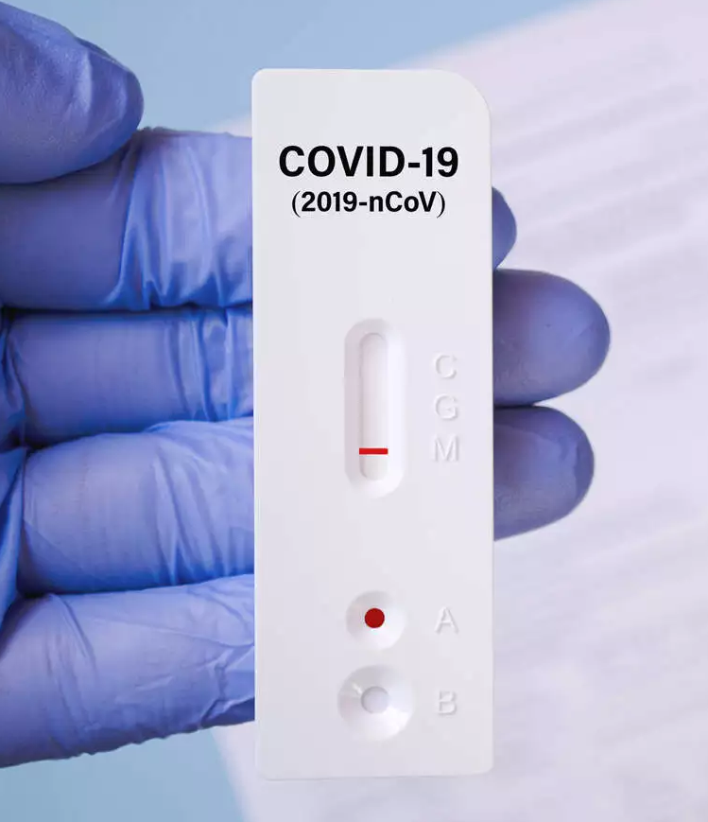
Objective of Project
This Study can help to check the Risk of Covid-19 patient by giving the Risk in terms of Percentage.
Checking risk sitting at remote places.
Assistance for doctors to treat the patients with high risk on a priority basis.

Slide 4
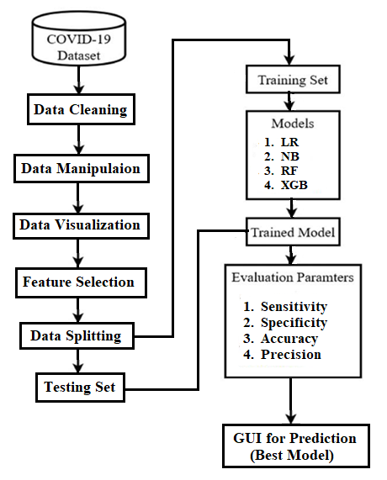
System Architecture

Slide 5




Technological Stack

Slide 6
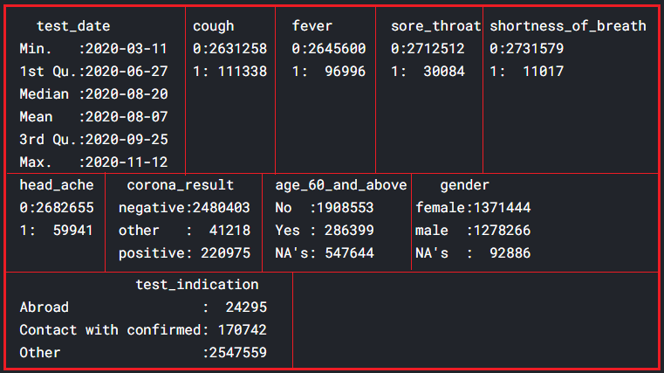
Step 1: Data Gathering
Dataset: Israel Government
Features:
Total Records: 27,42,596.
Target Feature: Corona Result.
Type: Classification.

Slide 7
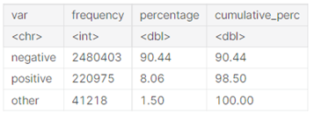
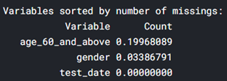

Step 2: Data Cleaning & Imputation
Analyzing Target Attribute: Corona result
Imputing Missing Values: Mice Imputer
Eliminating tuples: corona result = others

Slide 8

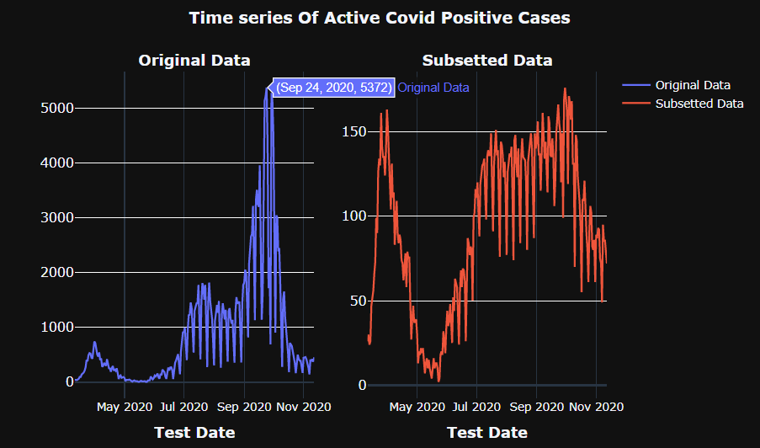
Step 3: Data Visualization & Manipulation
Maximum Cases were found in September month.
Removed the duplicates.
Encoded the Categorical Data using Label Encoding & One Hot Encoding.

Slide 9

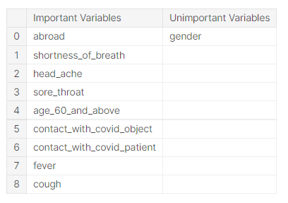
Step 4: Feature Selection
FS Technique: Chi-Square Test.
Feature Relevance:

Slide 10
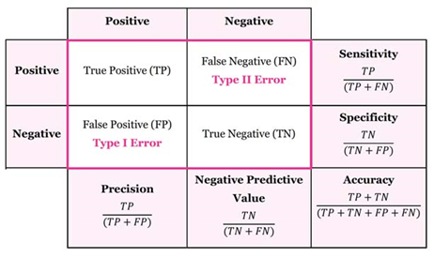
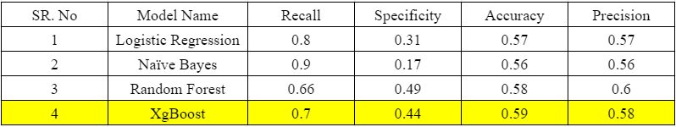
Step 5: Data Modeling
Data Splitting: Train-Test (70:30).
ML models: Logistic Regression, Naïve Bayes, Random Forest, Extreme Gradient Boosting.
Testing on model: Test Dataset.
Model Comparison: Evaluation Metrics.
Output: Best Model (XGB) - Pickle file.

Slide 11
User Interface

Slide 12
Conclusion
There were 26,58,462 duplicate records in dataset.
Maximum Covid - positive patients were found in September month.
After performing chi square test, non-important feature stated was Gender.
XgBoost performs slightly better than other models in Predicting the Risk.

Slide 13
Work Distribution
Data Gathering: Sana Shaikh & Rutuja Vaidya.
Data Cleaning & Imputation: Siddharth Kulkarni.
Data Visualization & Manipulation: Rutuja Vaidya.
Feature Selection: Atharv Chaudhari.
Data Modeling: Sana Shaikh & Omkar Patil.
Testing: All 5 members.
User Interface: Atharv Chaudhari & Omkar Patil.

Slide 14
References & Links
^{[1]} A paper based on future forecasting about machine learning models
https://ieeexplore.ieee.org/stamp/stamp.jsp?tp=&arnumber=9099302
^{[2]} Using machine learning approaches, detection of COVID-19 from clinical text data
https://ieeexplore.ieee.org/stamp/stamp.jsp?tp=&arnumber=9184922
GitHub:
https://github.com/mykeysid10/Sem-6-Risk-Prediction-of-Covid-19-Cases

Slide 15


